Slide 1
DIAGNOSIS OF ACUTE DISEASES IN VILLAGES AND SMALLER TOWNS USING AI
PIP2001 Capstone Project
Review-2
Batch Number : CAI-G14
Roll Number | Student Name
20211CAI0155 20211CAI0153 20211CAI0121 20211CAI0099 20211CAI0131 | Benakeshwar G K Vishwas Chandra C Gautham Ashwani Darshan Karthik K J Preethi N
Under the Supervision of,
Dr. MURALI PARAMESWARAN
Professor
School of Computer Science and Engineering
Presidency University
Name of the Program: B.E in Computer Science and Engineering , Specialization in Artificial Intelligence & Machine Learning
Name of the HoD: Dr. Zafar Ali Khan
Name of the Program Project Coordinator: Dr. Afroz Pasha
Name of the School Project Coordinators: Dr. Sampath A K / Dr. Abdul Khadar A / Mr. Md Ziaur Rahman

Slide 2
Introduction
Limited access to healthcare in rural areas leads to challenges in diagnosing
serious illnesses.
Timely and accurate health information is crucial for early diagnosis and
effective treatment.
Development of a chatbot to provide instant help in diagnosing serious diseases.
Acts as a virtual doctor for remote areas.

Slide 3
Abstract
AI Chatbot Solution:
Bridges the healthcare gap with AI-powered assistance.
Utilizes a comprehensive medical knowledge base.

Slide 4
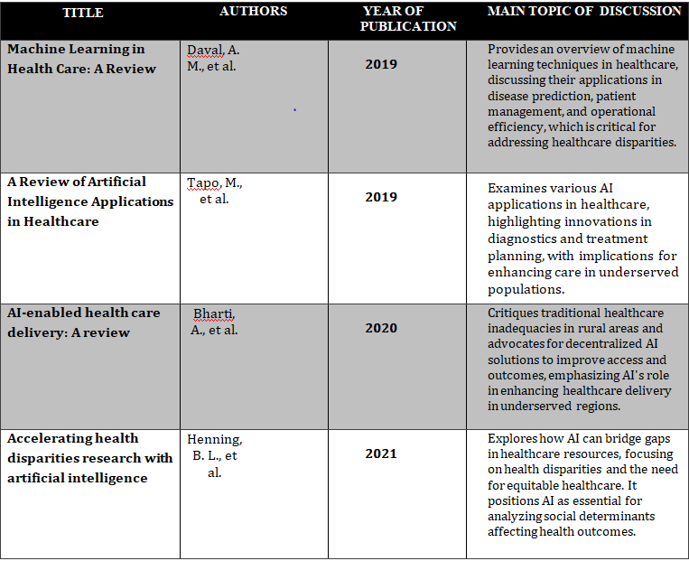
Literature Review

Slide 5
Drawbacks Of Existing Methods
Analization of the Lack of Regional Language Support Currently: current chatbot applications have a major disadvantage that it is not possible to use the regional language
The effect of the Interaction of the user: A review of current user engagement research provides evidence that incomplete symptom and medical history data are postcode challenges within chatbot systems
Hardware Requirements: Most of the chatbot systems require the devices to be powerful enough, have enough memory and the latest software installed.

Slide 6
Proposed Method
Data Extraction and Chunking
Embedding Creation and Semantic Indexing
Knowledge Base Development
User Query Processing
Response Generation with Llama 2
Patient Empowerment and Self-Management

Slide 7
Objectives
Early and accurate detection
Access to Affordable Healthcare
Reduces caregiver burden
Ensures equitable care for vulnerable population
Emergency Assistance
Health Education

Slide 8
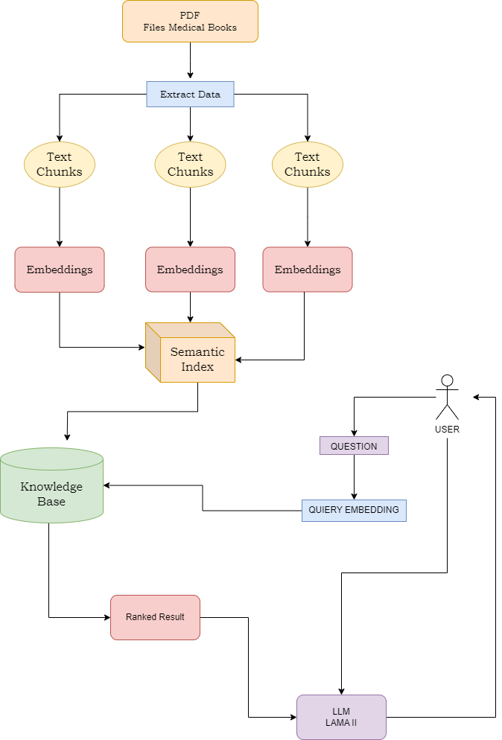
Architecture

Slide 9
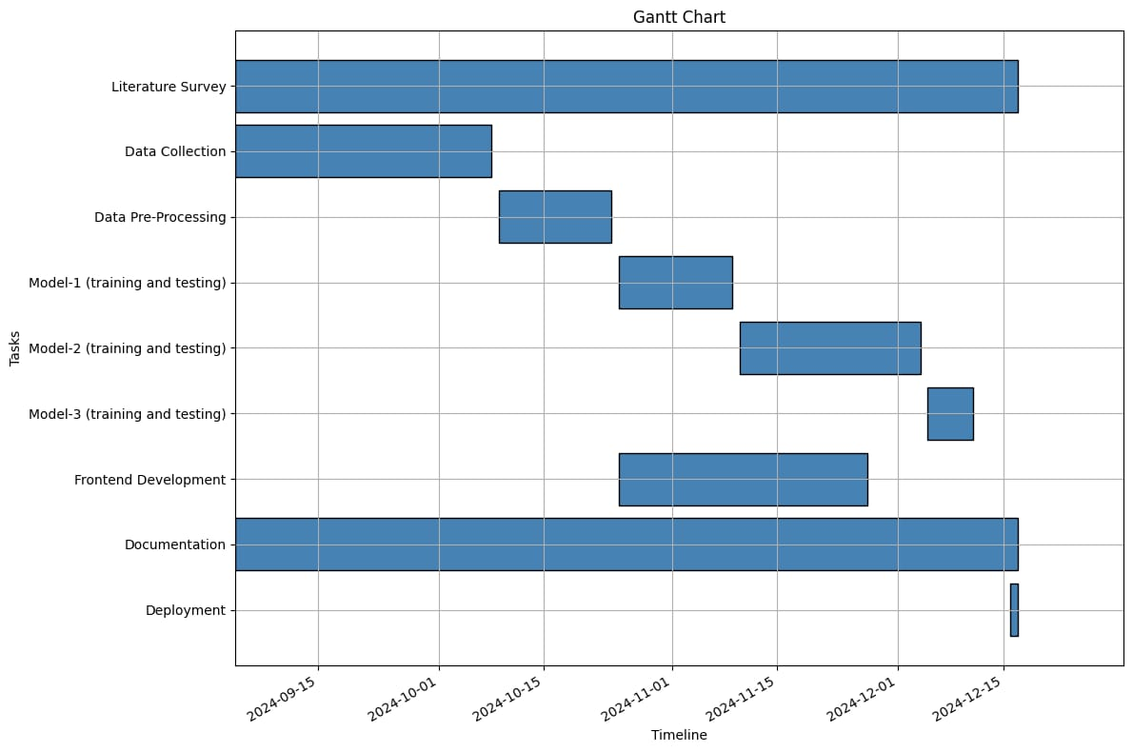
Timeline of Project

Slide 10
Expected Outcomes
Improved accessibility: The combination of information and communication technologies with healthcare services will make them available to the rural areas thereby improving on their health by helping with diagnosis
Improved Health Outcomes:. By facilitating quicker access to medical advice, the chatbot will empower individuals to take proactive steps towards their health.

Slide 11
Conclusion
The project aim’s to help improve rural healthcare through AI.
It provides early diagnosis, easing healthcare worker burdens and offering affordable, scalable care.
Future efforts will focus on refining AI models and enhancing integration with local healthcare systems.

Slide 12
Github Link
https://github.com/punyathma/A-cuteAI

Slide 13
References
Kumar Y, Koul A, Singla R, Ijaz MF. "Artificial intelligence in disease diagnosis: a systematic literature review, synthesizing framework and future research agenda." J Ambient Intell Humaniz Comput. 2023;14(7):8459-8486. doi:10.1007/s12652-021-03612-z.
Guo, Jonathan & Li, Bin. (2018). "The Application of Medical Artificial Intelligence Technology in Rural Areas of Developing Countries." Health Equity. 2:174-181. doi:10.1089/heq.2018.0037.
Pathak, Chandramaprasad and Ansari, Namrata. "Chatbot based Disease Prediction and Treatment Recommendation using AI." (May 7, 2021).
Available at SSRN: https://ssrn.com/abstract=3869072
Fan X, Chao D, Zhang Z, Wang D, Li X, Tian F. "Utilization of Self-Diagnosis Health Chatbots in Real-World Settings: Case Study." J Med Internet Res. 2021 Jan 6;23(1)
Diagnosis Of Acute Diseases In Villages And SmallerTowns Using AIMohammed Naseeruddin Taufiq, Bandaru Bhavagna Shreya, Sahil Anil Thole Chitra S, A.Mohammed A
Using AI, Diagnosis of Acute Diseases in Villages and Smaller TownsMadhu H T1, Sachin S2, Manjunath Kavishetti3 , Puneeth4 , Karthik Mahesh Gadyal5
.Chakraborty, Sanjay, Paul, Hrithik, Ghatak, Sayani, Pandey, Saroj, Kumar, Ankit, Singh, Kamred, & Shah, Mohd Asif. (2023). "An AI-Based Medical Chatbot Model for Infectious Disease Prediction." IEEE Access. PP. 1-1. doi:10.1109/ACCESS.2022.3227208.

Slide 14
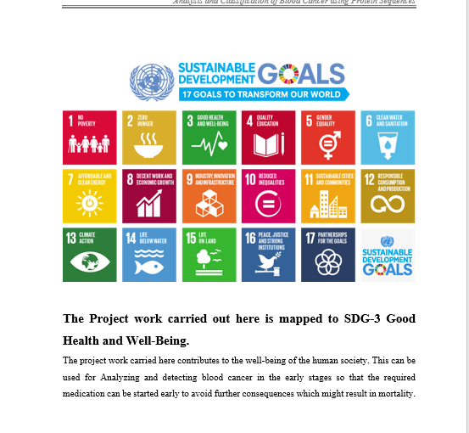
Project work mapping with SDG
SDG 1:No Poverty
The main Idea behind our project is to aid healthcare to all , without any poverty barrier.
SDG 3: Good Health and Well-Being
Promoting best possiible health diagnostics to all for everyone’s well-being.
SDG 9: Industry, Innovation, and Infrastructure
Our project , AI in medicine , hasn’t made a big market yet , making space for much more innovation and improvement in the particular Industry.
SDG 10: Reduced Inequalities
Provinding equal health facilities to all , without any barriers.
SDG 17: Partnerships for the Goals
By tying up with Non Profitable Organizations , Charitable Trusts , our project is open in looking for partnerships to fulfill our future goals.

Slide 15
Thank You

